Slide 1

Will it be viral?
Presented By
Group 13 – Hamza Karachiwala, Kedar Amrolkar, Mickey Vellukunnel

Slide 2
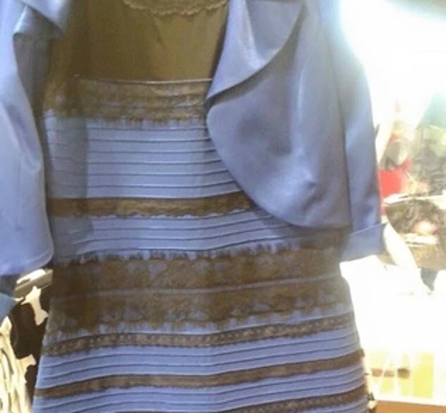

Familiar?
5
10
Notes:
Start from here maybe – 1st slide should be

Slide 3
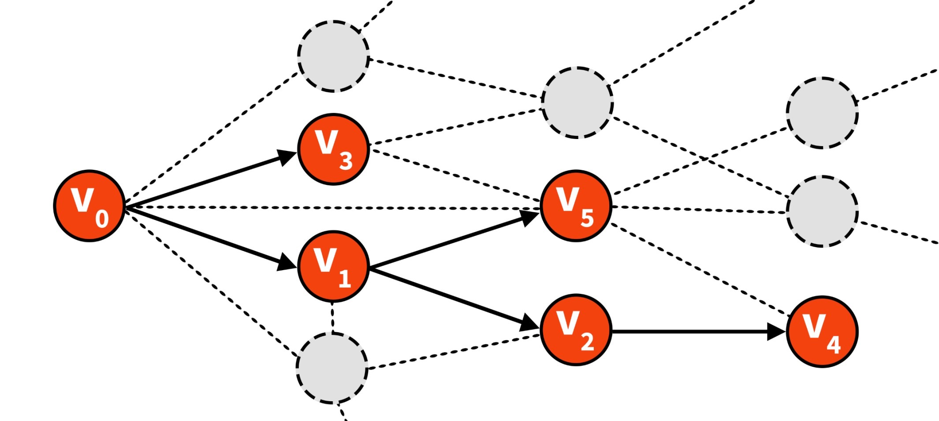
5/30/2014
Jure Leskovec, Stanford University

Slide 4







As users of social media sites
(re)share information
big cascades form
5/30/2014
Jure Leskovec, Stanford University
10

Slide 5

5/30/2014
Jure Leskovec, Stanford University

Slide 6
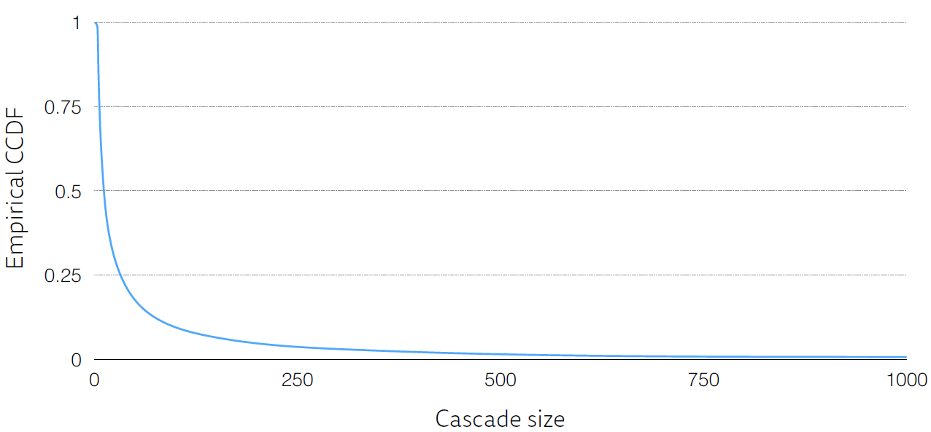
Large cascades are extremely rare
5/30/2014
Jure Leskovec, Stanford University

Slide 7
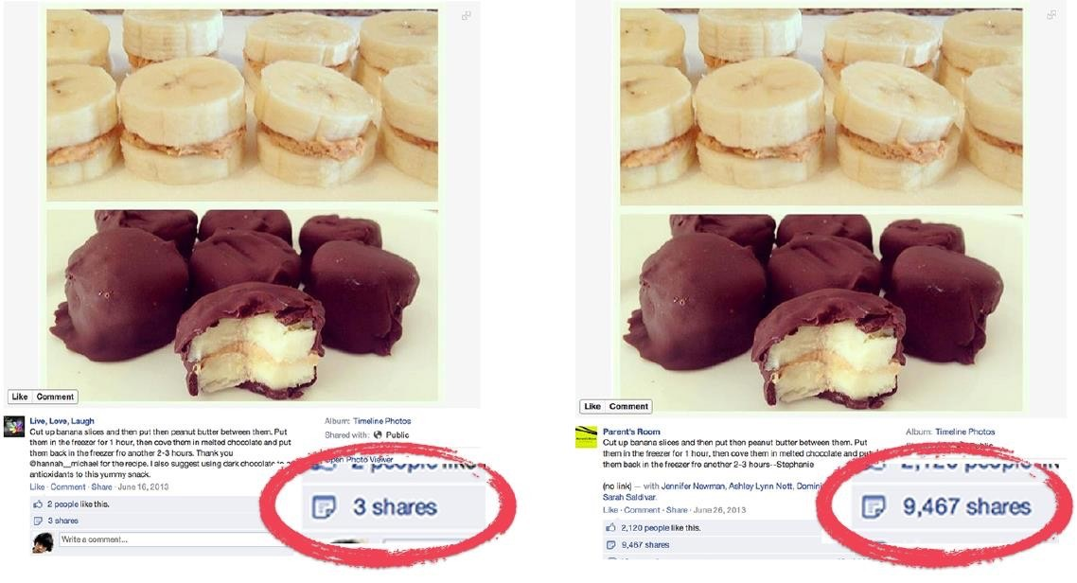
Same content, very different popularity
5/30/2014
Jure Leskovec, Stanford University

Slide 8
Increasing the strength of social influence increases both inequality
and unpredictability of success.
Salganik, M. J., Dodds, P. S., & Watts, D. J. (2006). Experimental study of inequality and unpredictability in an artificial cultural market.
5/30/2014
Jure Leskovec, Stanford University

Slide 9
Can I answer the question, will it go viral?

Slide 10
Cascades are predictable!
Justin Cheng , Lada A. Adamic, P. Alex Dow, Jon Kleinberg, Jure Leskovec,
World Wide Web Conference ‘14
Content
5/30/2014
Jure Leskovec, Stanford University

Slide 11
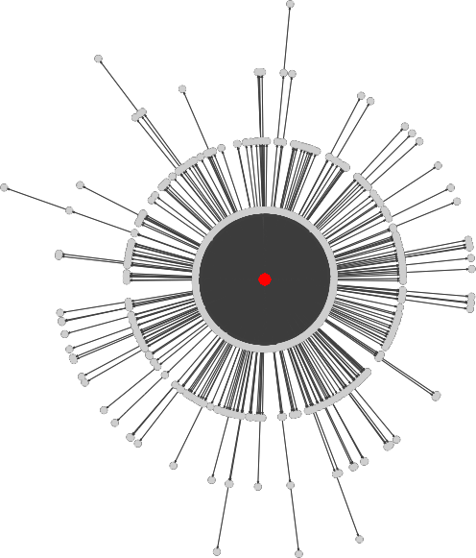
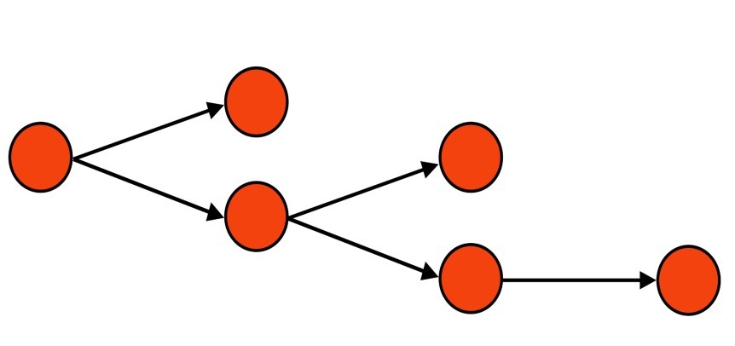

?
How to formulate the
prediction problem?
5/30/2014
Jure Leskovec, Stanford University
20

Slide 12
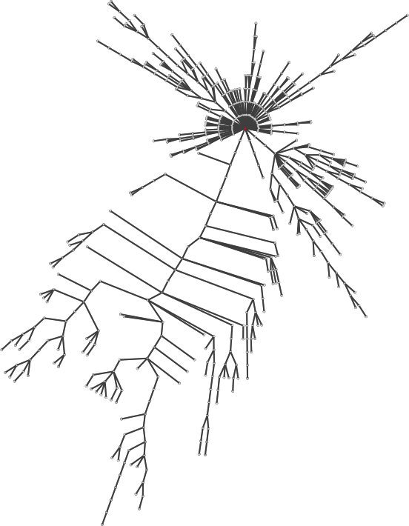
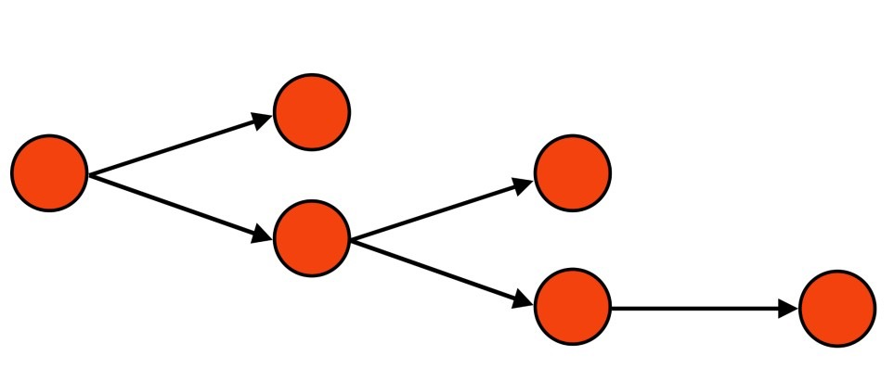

Predict whether a cascade will
get >k reshares?
?
5/30/2014
Jure Leskovec, Stanford University
21

Slide 13


Predict whether a cascade will
get >k reshares?
?
5/30/2014
Jure Leskovec, Stanford University
21

Slide 14
Predict the exact number of nodes
in a cascade
?
5/30/2014
Jure Leskovec, Stanford University
22

Slide 15

Predict the exact number of nodes
in a cascade
?
5/30/2014
Jure Leskovec, Stanford University
22

Slide 16
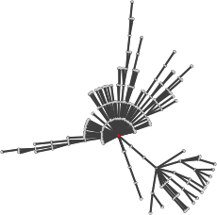
Only look at cascades with a minimum number of reshares and predict future growth
?
5/30/2014
Jure Leskovec, Stanford University
23

Slide 17

Only look at cascades with a minimum number of reshares and predict future growth
?
5/30/2014
Jure Leskovec, Stanford University
23

Slide 18
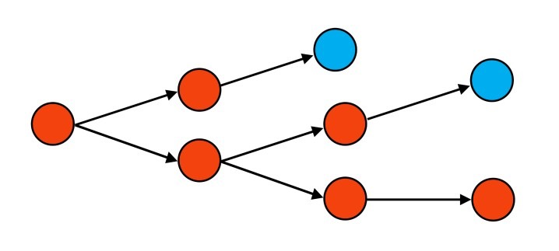

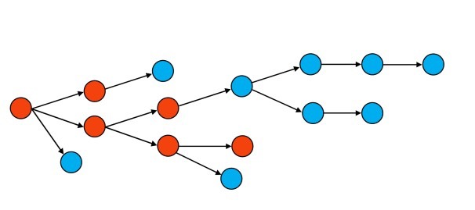
Will a cascade reach the median
size?
?
less than the median f(k)
?
k reshares
more than the
median f(k)
For cascades of size ≥ 𝒌 let the
𝒇(𝒌) be their median final size
5/30/2014
Jure Leskovec, Stanford University

Slide 19
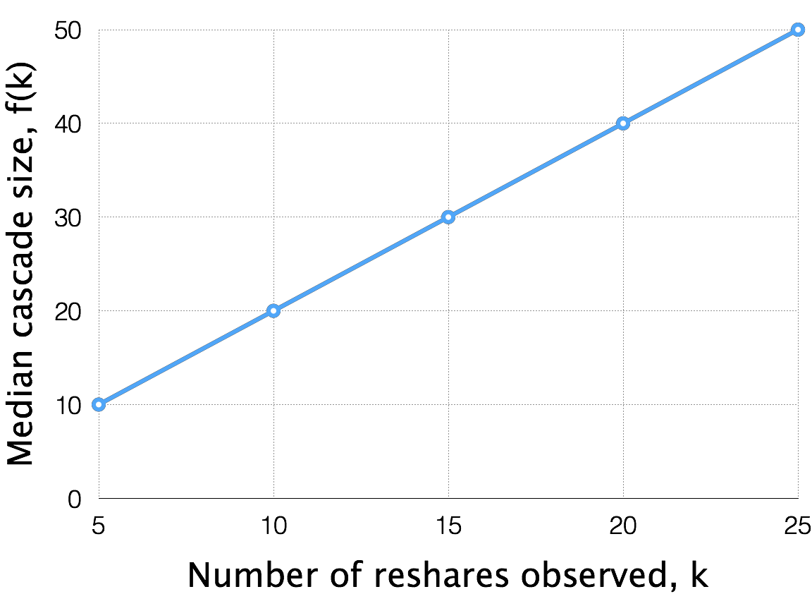
5/30/2014
Jure Leskovec, Stanford University

Slide 20



Will a cascade double in size?
?
≤2k reshares = f(k)
?
>2k reshares = f(k)
k reshares
5/30/2014
Jure Leskovec, Stanford University

Slide 21


Given that a cascade has obtained k reshares, will it grow beyond the median size f(k)=2k?
5/30/2014
Jure Leskovec, Stanford University
27

Slide 22


Given that a cascade has obtained k reshares, will it grow beyond the median size f(k)=2k?
5/30/2014
Jure Leskovec, Stanford University
27

Slide 23




The authors used anonymized Facebook photo re-sharing data from June 2013 to reconstruct reshare cascades using click, impression, and friend/follower data
Using features of the cascade,
we evaluate the performance of a classifier
5/30/2014
Jure Leskovec, Stanford University

Slide 24
Content
(e.g. has overlaid text)
User
(e.g. follower count)
Structural
(e.g. proximity to root in G)
Temporal
(e.g. time between reshares)
5/30/2014
Jure Leskovec, Stanford University

Slide 25
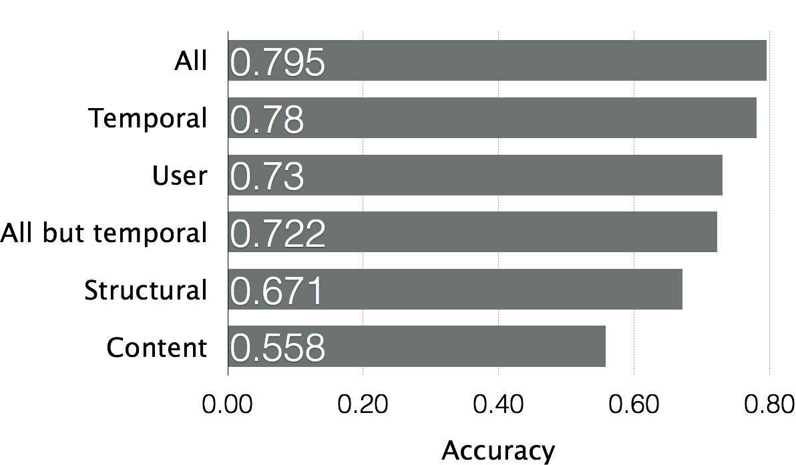
All but temporal
Will a cascade double (k=5)?
5/30/2014
Jure Leskovec, Stanford University
30

Slide 26
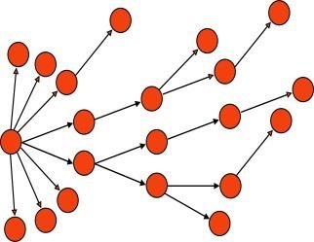
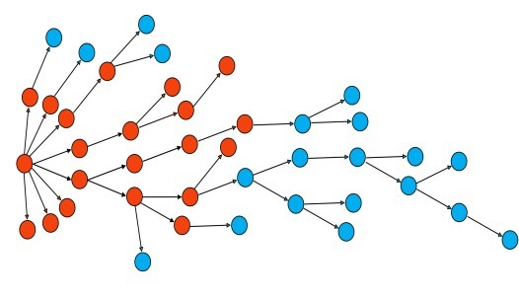

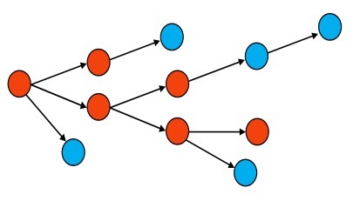
How does predictability change
with k?
vs.
5 reshares
> 10 reshares?
20 reshares
> 40 reshares?
▪
▪
▪
5/30/2014
Jure Leskovec, Stanford University
31

Slide 27

How does predictability change
with k?
vs.
5 reshares > 10 reshares? ^{20 reshares > 40 reshares?}
Two opposing arguments:
Easy: see more of the cascade
Hard: predict farther into the future
5/30/2014
Jure Leskovec, Stanford University
31

Slide 28
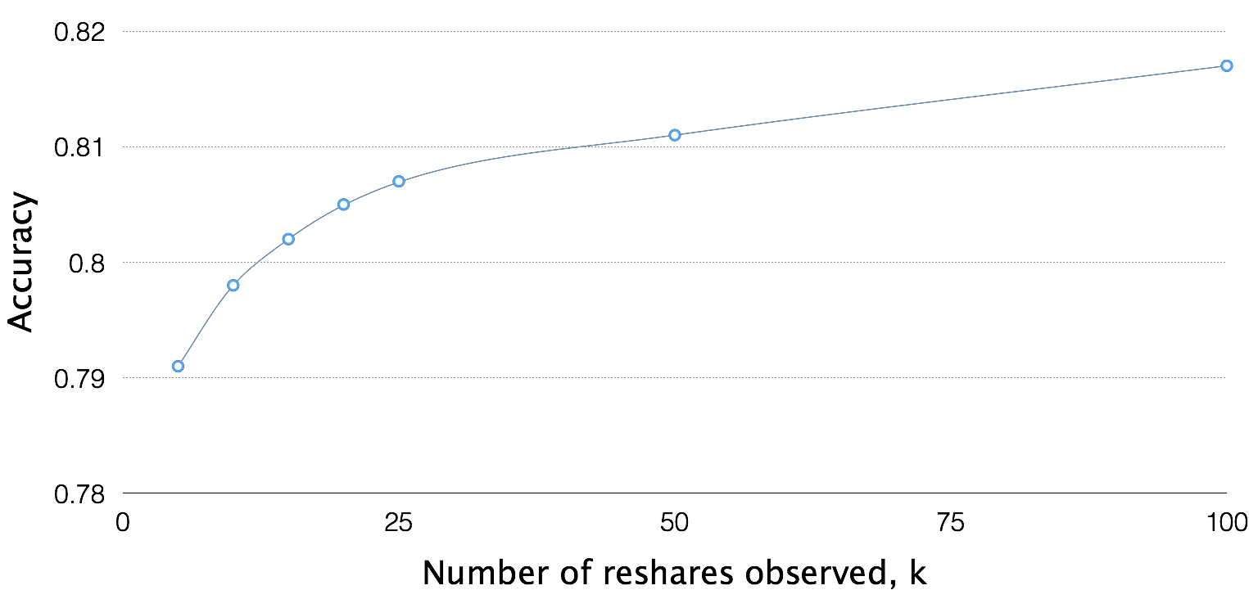
5/30/2014
Jure Leskovec, Stanford University

Slide 29
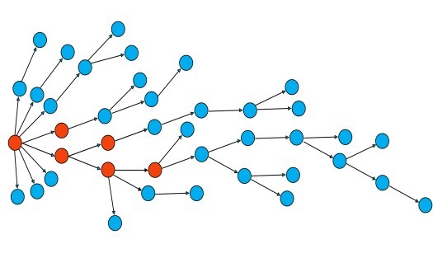



Fix the minimum cascade size R ≥ k
How does predictability change with k?
vs.
5 reshares >40 reshares? 20 reshares >40 reshares?
Is there a “sweet” spot when we have enough information to be able to predict?
5/30/2014
Jure Leskovec, Stanford University

Slide 30
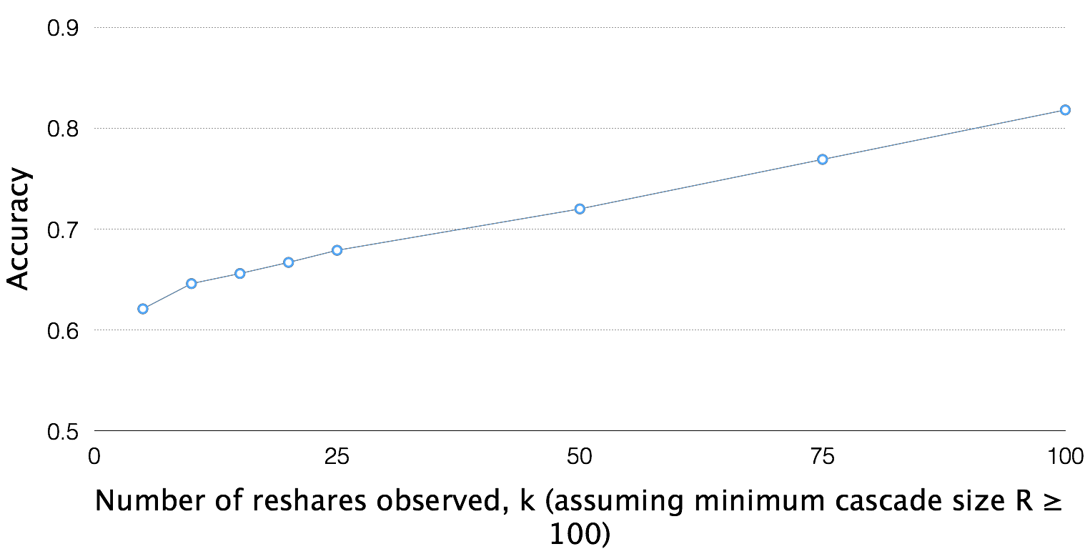
5/30/2014
Jure Leskovec, Stanford University

Slide 31
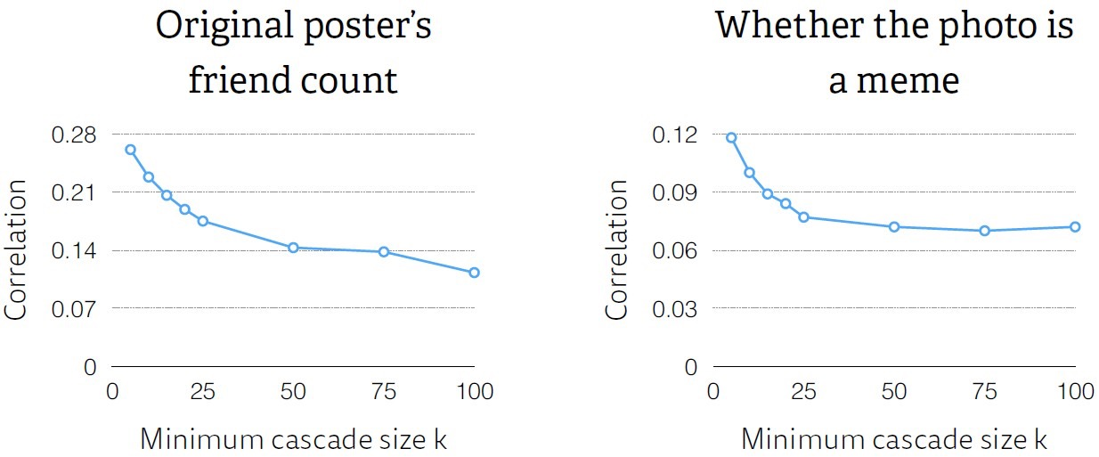
The original post (and poster) get
less important with increasing k
5/30/2014
Jure Leskovec, Stanford University

Slide 32
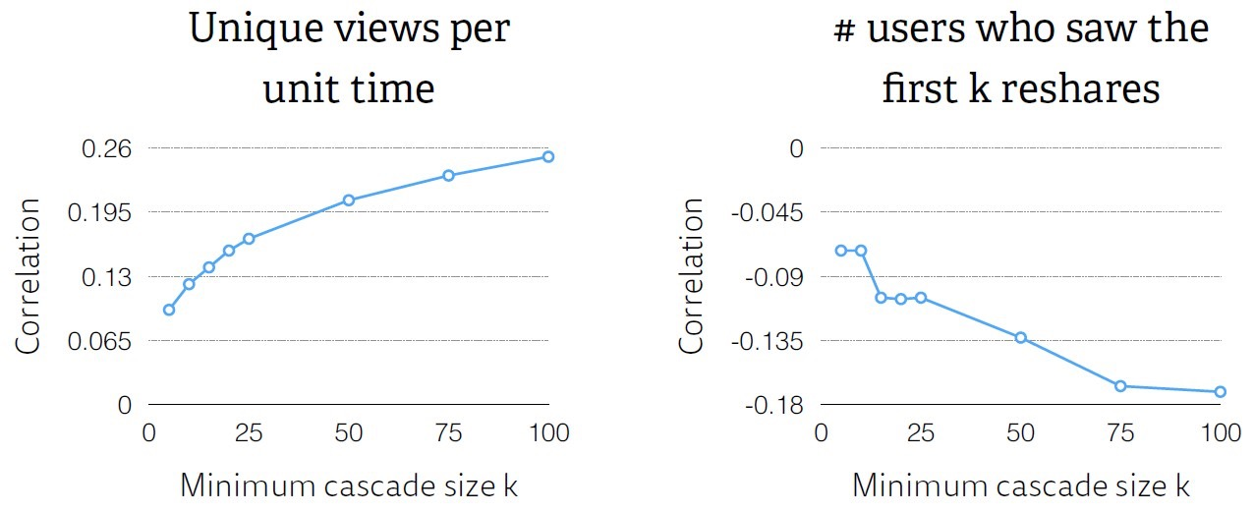
Successful cascades get many views quickly, and achieve high conversion rates
5/30/2014
Jure Leskovec, Stanford University

Slide 33
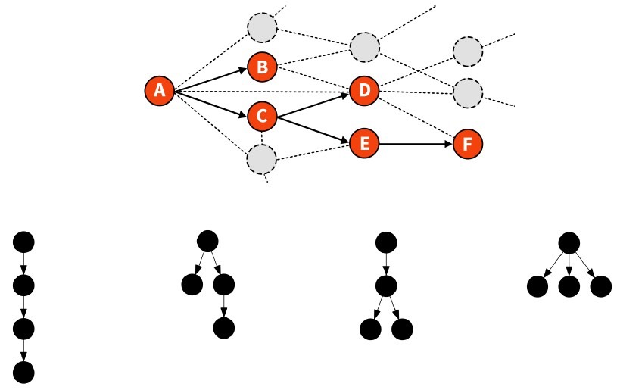
5/30/2014
Jure Leskovec, Stanford University

Slide 34
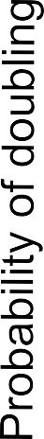
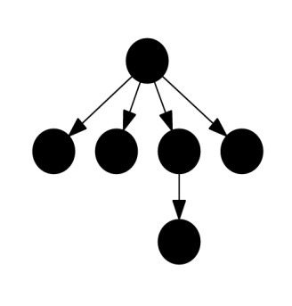
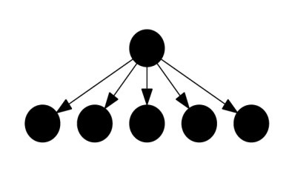

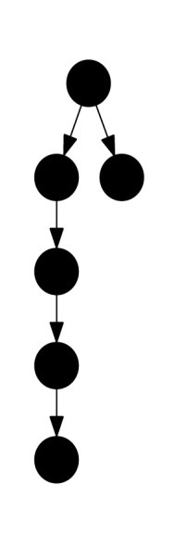
…
5/30/2014
Jure Leskovec, Stanford University

Slide 35
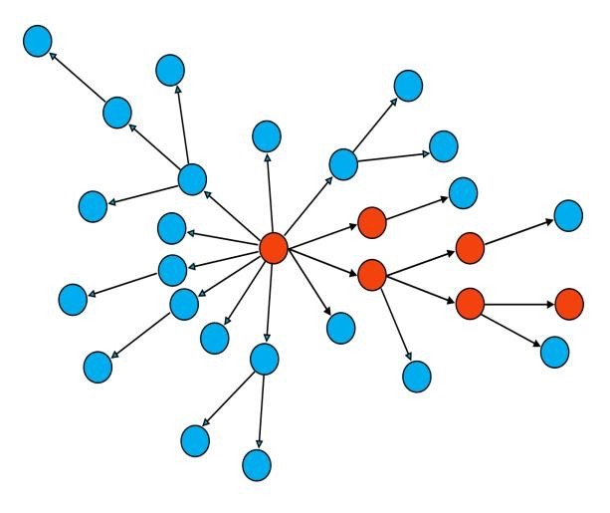
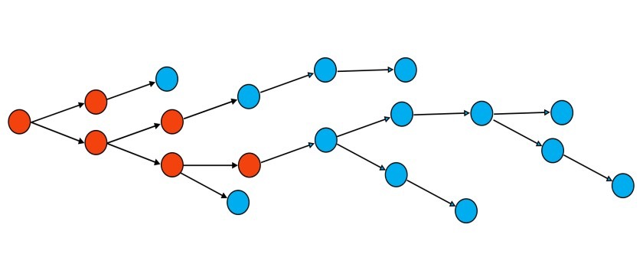
Predictability of cascade structure:
?
?
5/30/2014
Jure Leskovec, Stanford University

Slide 36

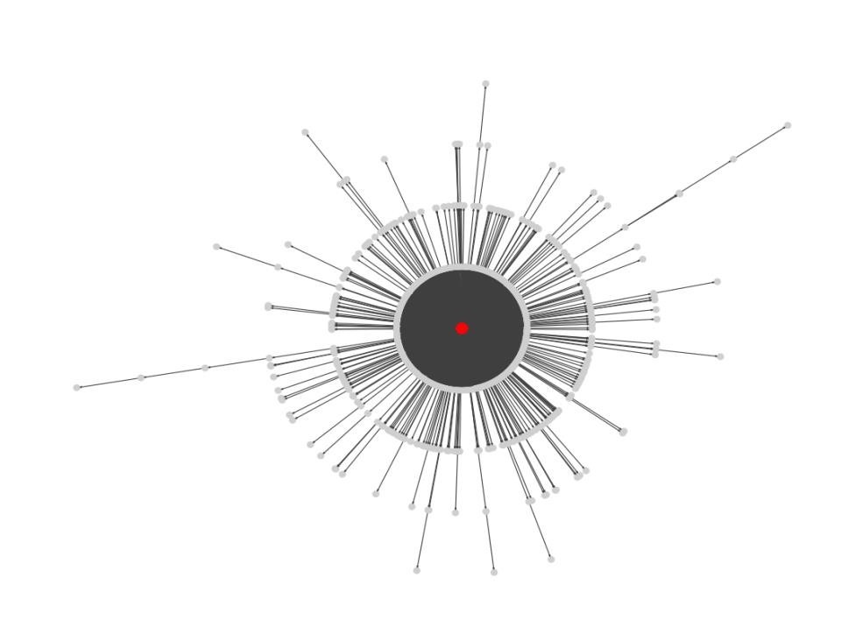
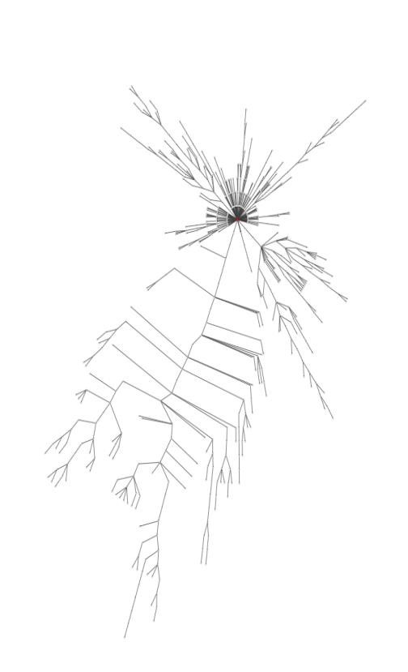
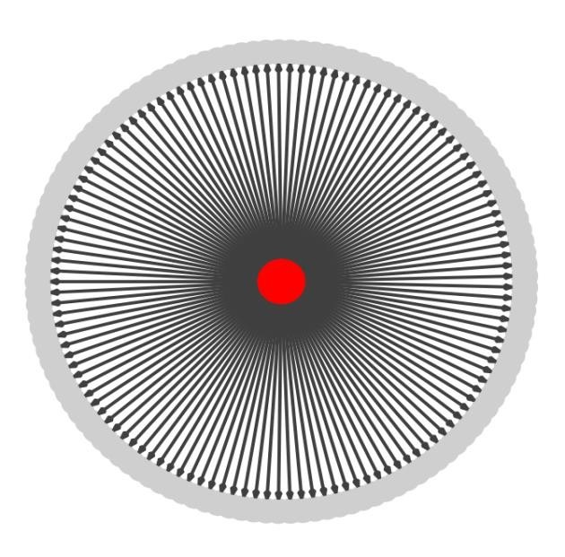
Wiener index: Mean all-pairs shortest
path distance in a cascade
d = 1.98 d = 2.47 d = 14.4
Anderson, A., Goel, S., Hofman, J. & Watts, D. J. The structural virality of online diffusion.
5/30/2014
Jure Leskovec, Stanford University
40

Slide 37
Will a cascade have structural
virality above the median?
5/30/2014
Jure Leskovec, Stanford University
41

Slide 38



Will a cascade have structural
virality above the median?
5/30/2014
Jure Leskovec, Stanford University
41

Slide 39
Can we differentiate cascades of the same content?
5/30/2014
Jure Leskovec, Stanford University

Slide 40
5/30/2014
Jure Leskovec, Stanford University

Slide 41

Consider identical photos uploaded to Facebook, generating 983 clusters, 38k photos, 13m reshares
For each cluster, we select ten random cascades, and predict which was the largest
Random guessing: 10% accuracy
5/30/2014
Jure Leskovec, Stanford University

Slide 42
Can we predict the largest of 10 random chosen cascades of the identical image?
5/30/2014
Jure Leskovec, Stanford University
46

Slide 43


Can we predict the largest of 10 random chosen cascades of the identical image?
5/30/2014
Jure Leskovec, Stanford University
46

Slide 44
So…how do I make my
posts go “viral”?
5/30/2014
Jure Leskovec, Stanford University

Slide 45
5/30/2014
Jure Leskovec, Stanford University

Slide 46
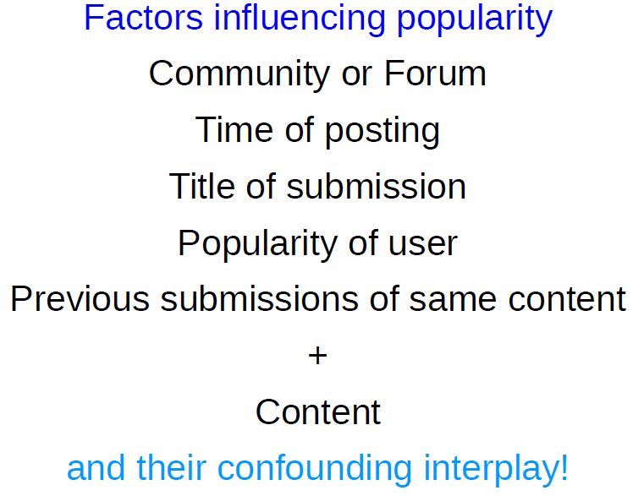
Given a piece of content, can we
maximize probability of its success?
5/30/2014
Jure Leskovec, Stanford University

Slide 47

Cascades are predictable
The cascade growth prediction problem, allows us to accurately predict the future growth of a cascade, even as it continues to grow in size
5/30/2014
Jure Leskovec, Stanford University

Slide 48
Thank you !
And may all your posts be viral!
70

